Slide 1
Shortcuts
Customer Relationship Management Application for Android Tablets

Slide 2
Executive Summary
Customer Relationship Management Application
Unique Selling Point: Integrating photos with customer records
First of Its Kind: The company will be seen as an innovator
Untapped Market: Not much competition in CRM for Android
Desirable Pricing: Targeting businesses allows for higher prices
Worldwide Potential: Small footprint makes translation easy
Low Cost: Project needs only two devs and one manager

Slide 3
Product Description
‘Shortcuts’ is a customer relationship management application for tablets. It is targeted at barbers, hairdressers and other personal grooming businesses. The proprietor can create an account for each of their clients and take pictures of their results (haircuts, nails, etc). The user can review those pictures in the future by looking up the client's account.

Slide 4
Core Application Functionality
Create account for each customer
Take pictures of customers for account
Review pictures of previous visits in future

Slide 5
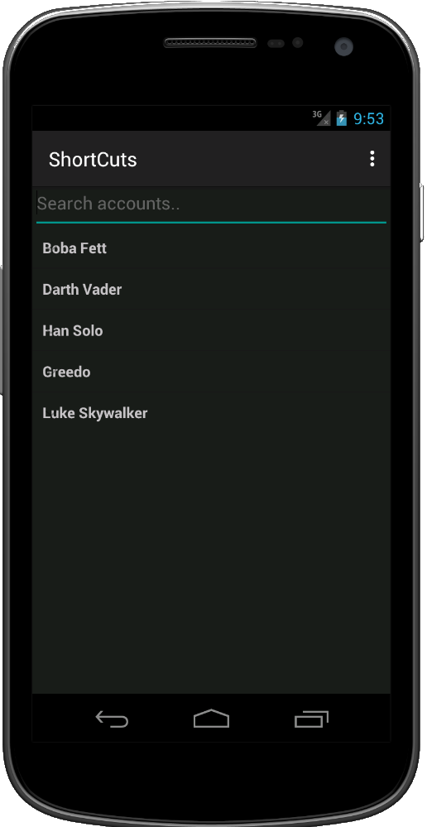
What Can It Do For Me?
Create an account for each customer.
Manage your business with a list of your clientele.

Slide 6
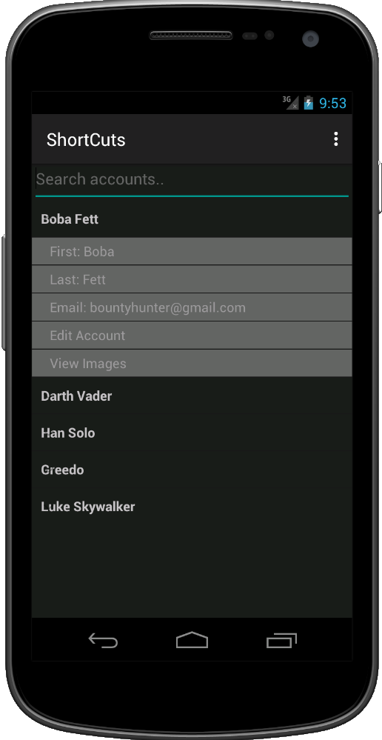
What Can It Do For Me?
Review customer data with a single tap.
Connect with each of your clients with the help of technology.

Slide 7
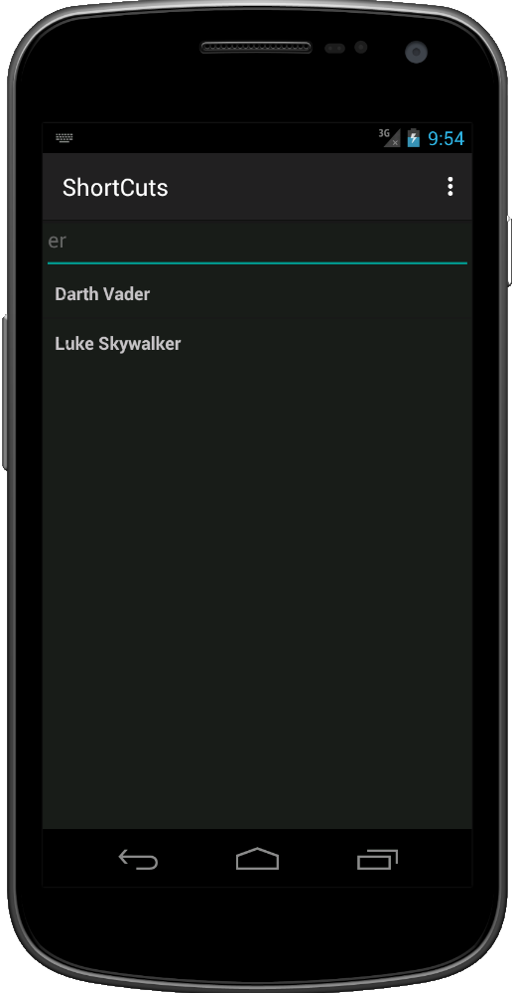
What Can It Do For Me?
Find accounts with wildcard searching.
Even with hundreds of clients, you can find them in mere moments.

Slide 8
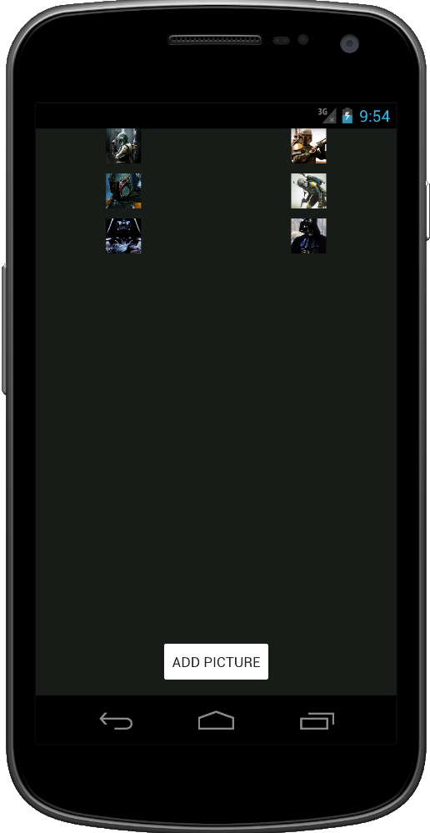
What Can It Do For Me?
View all of a client’s pictures in a gallery.
Build a personal history with your clients, as well as a bright future.

Slide 9
Product Demographics
This product is targeted at small business owners. More specifically, it is intended for businesses that are part of the personal grooming industry, though the product may be adopted by other tech-savvy entrepreneurs.
The customer base is large and underserved!

Slide 10
Who is the competition?
Our main competition are other CRM apps on the Android Marketplace:
Customer Events Records CRM-L from Siyami Apps, LLC
Base CRM from Base CRM (Future Simple)
Client Manager from CV Developers
Pipedrive - Sales CRM from Pipedrive Inc.
Zoho CRM from Zoho Corporation

Slide 11
There is no real competition!
...But none of these existing customer relationship management applications for the Android replicate the unique functionality of our application.
This application is one of a kind!

Slide 12
SWOT Matrix
Strengths First of its kind Little impact on device No direct competition with our unique functionality | Weaknesses No reputation established Low marketing budget Low borders to entry Competition could adapt to include our unique functionality
Opportunities Establishing name as first of its kind Offer free trial version for outside markets before launching paid version | Threats Bigger companies with larger marketing budgets Agile companies that could change to include our functionality

Slide 13
Distribution Channels
This product will be distributed through the Google Play online storefront for Android devices.
This product could be brought to iOS devices, but there is no plans to do that at this time.

Slide 14
Geographic Coverage
North American GooglePlay market (region locked for paid apps)
Coverage could include other English speaking countries
Future coverage could include countries that primarily use the implemented translations.

Slide 15
What Comes Next? Roadmap 2015/16
June 2015: First release.
December 2015: Cloud backup release. Translation options added for Spanish and French, German and Portuguese.
June 2016: Translation options added for Mandarin, Cantonese, Tagalog and Japanese.

